Slide 1
 | Make
PK | MakeId
 | Make
FK | UserId
 | Sales
PK | SaleId
FK | VehicleId
FK | UserId
FK | CustId
 | SalePrice
 | purchType
 | Users
PK | UserId
 | LastName
 | FirstName
 | Email
 | isAdmin
 | Pwd (Encrypted)
 | Vehicle
PK | VehicleId
FK | MakeId
FK | ModelId
FK | ExteriorId
FK | InteriorId
FK | BodyId
 | MSRP
 | Year
 | isNew
 | isAutom
 | Miles
 | VIN
 | Description
 | DateAdded
 | PictPath
 | Roles
PK | RoleId
 | role
 | Color
PK | colorId
 | Color
 | Customers
PK | CustId
 | LastName
 | FirstName
 | Email
 | VIN
 | Featured
PK | FeatureId
FK | VehicleId
 | Description
 | Specials
PK | SpecialId
 | Title
 | Description
 | Model
PK | ModelId
FK | MakeId
 | UserId
 | BodyStyles
PK | BodyId
 | Body

Slide 2
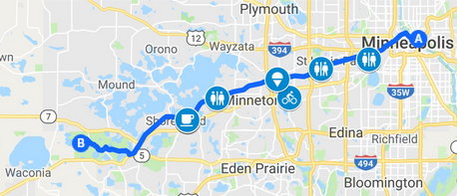
Sample Weekend Trip, mostly on bike trails

Slide 3
 | MakeTable
PK | MakeId
 | Make
FK | UserId
 | SaleTable
PK | SaleId
FK | VehicleId
FK | UserId
FK | CustId
 | SalePrice
 | purchType
 | Users
PK | UserId
 | LastName
 | FirstName
 | Email
 | isAdmin
 | Pwd (Encrypted)
 | BikeTable
PK | VehicleId
FK | MakeId
FK | ModelId
FK | ExteriorId
FK | InteriorId
FK | BodyId
 | MSRP
 | Year
 | isNew
 | isAutom
 | Condition
 | VIN SerialNum
 | Description
 | DateAdded
 | PictPath
 | RoleTable
PK | RoleId
 | role
 | ColorTable
PK | colorId
 | Color
 | CustomerTable
PK | CustId
 | LastName
 | FirstName
 | Email
 | VIN
 | FeatureTable
PK | FeatureId
FK | VehicleId
 | Description
 | SpecialTable
PK | SpecialId
 | Title
 | Description
 | ModelTable
PK | ModelId
FK | MakeId
 | UserId
 | FrameTable
PK | BodyId
 | Body

Slide 4
Featured Page
Featured
FeaturedId
BikeId
Year
Make
Model
Picture

Slide 5
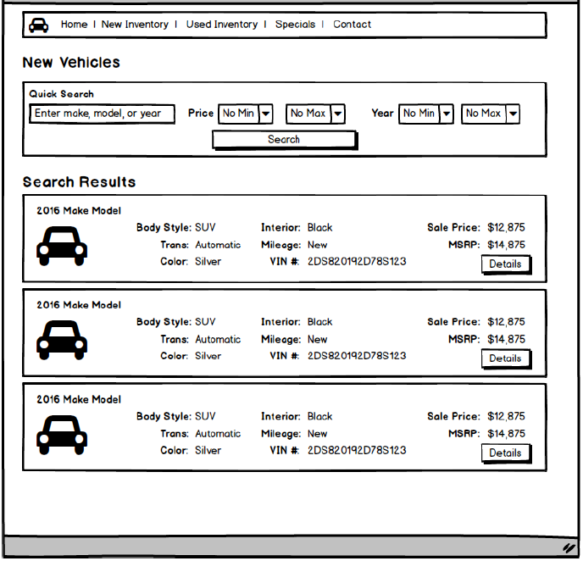
New & Used & Sales Vehicles
BikeTable
IsNew
Year
Make
Model
Frame(body)
NumGears (Transmission)
Condition (Mileage)
SerialNum (VIN)
MSRP
LIstPrice
BikePictName
Color
FrameColor (Exterior)
TrimColor (Interior)

Slide 6
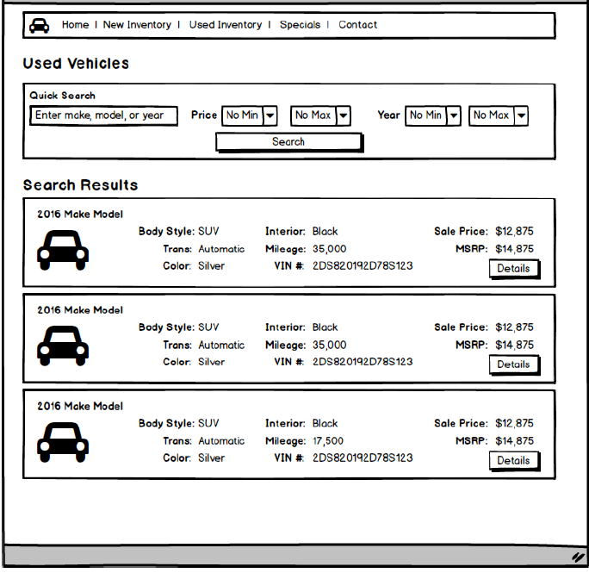
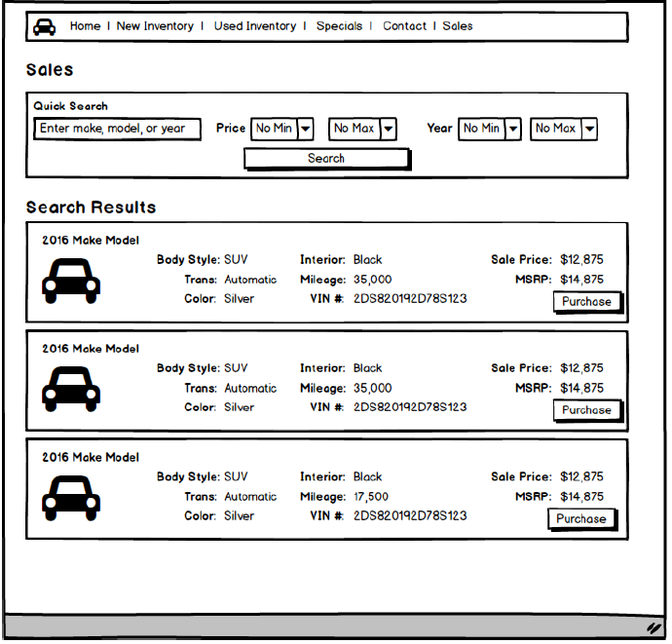
Comparing Views

Slide 7
Sales
BikeTable
IsNew
Year
Make
Model
Frame(body)
NumGears (Transmission)
Condition (Mileage)
SerialNum (VIN)
MSRP
Color
FrameColor (Exterior)
TrimColor (Interior)
PurchseTable
- Price

Slide 8
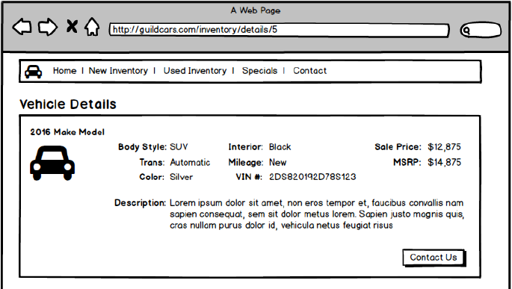
Bike Details
BikeTable
BikeId
Year
Make
Model
Frame (Body)
NumGears (Trans)
Condition
SerialNum
MSRP
ListPrice
ColorTable
FrameColorId (exteriorColor)
TrimeColorId (interiorColor)

Slide 9
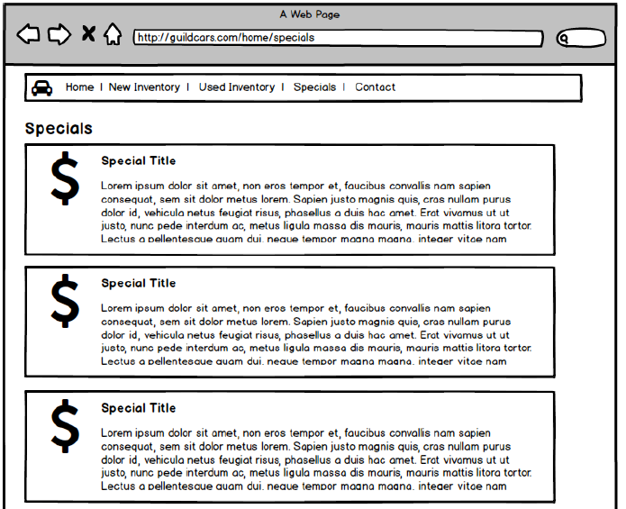
Specials
SpecialTable
SpecialId
Title
Description

Slide 10
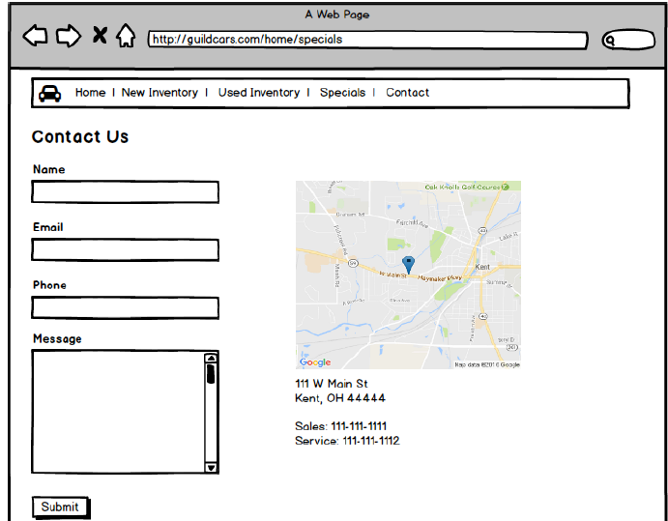
Contact Us
No tables
Save into contact table

Slide 11
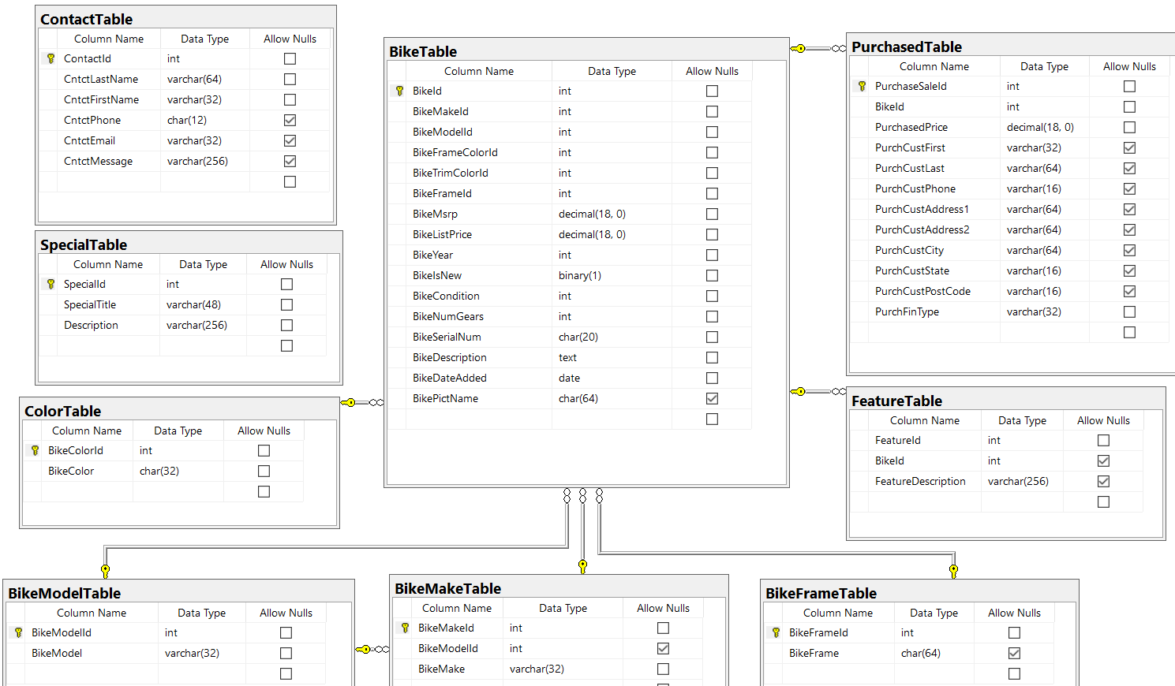

Slide 12
Price from purchase table is only used after a purchase is made.
Therefore, price in bike table is the asking price
For new bikes MSRP=price
For old bikes MSRP>price

